Slide 1

SVKM’s Institute of Technology, Dhule Department of Information Technology
Major Project Presentation
On
“Self-Checkout Smart Store System”
By
Name Roll
Vineet Chopade 11
Piyush Kumar Agrawal 02
Bhagyesh Katkar 18
Omprakash Bhamare 08
Guide
Ms. Rubi Mandal

Slide 2
SVKM’s Institute of Technology, Dhule Department of Information Technology
Project Title : Self-Checkout Smart Store System
Project Domain: Machine learning, Computer vision, Internet of Things.
Self-Checkout Smart Store System

Slide 3
Introduction
The self-checkout store system is a retail solution aimed at revolutionizing the traditional shopping experience. This innovative concept leverages advanced technology and automation to provide customers with a seamless and efficient checkout process.
The self-checkout store utilizes computer vision, machine learning, Sensor technology, and Digital Payment System to enable customers to shop freely without the need for traditional checkout counters or cashier assistance.
Self-Checkout Smart Store System

Slide 4
Problem Statement
Customers and retailers both face issues like lost revenue, reduced customer loyalty, waste of time, and product abandonment due to long queues in stores. To develop a system which resolves these issues to enhance the shopping experience, increase customer satisfaction, and boost sales by providing a seamless, secure, and user-friendly self-checkout process.
Self-Checkout Smart Store System

Slide 5
Aim and Objectives of the Project
The project aims to address common challenges faced by both customers and retailers, such as long queues, cashier errors, and inventory management inefficiencies to provide customers with a seamless and efficient checkout process.
Project objectives:
Retailers can reduce labour costs
Minimize checkout waiting time
Improve customer satisfaction
Self-Checkout Smart Store System

Slide 6
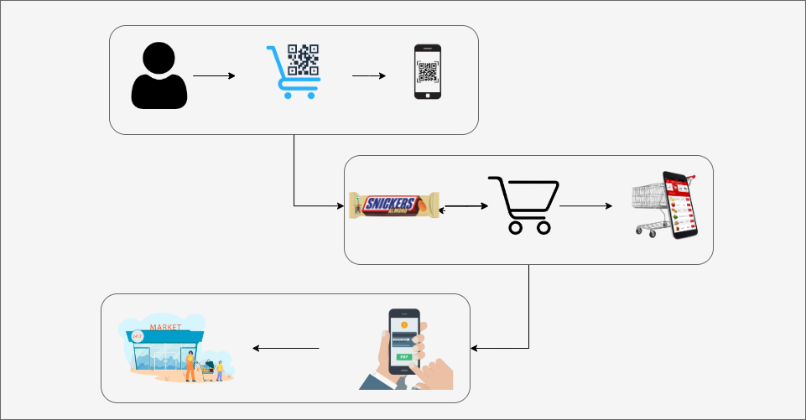
Working Model
Customer have to scan QR code on the Cart which will link the Cart to his Account.
2. The items added to the Cart will also be added to Customer's Virtual Cart.
3. Bill will be generated and customer can pay through mobile application.
Self-Checkout Smart Store System

Slide 7
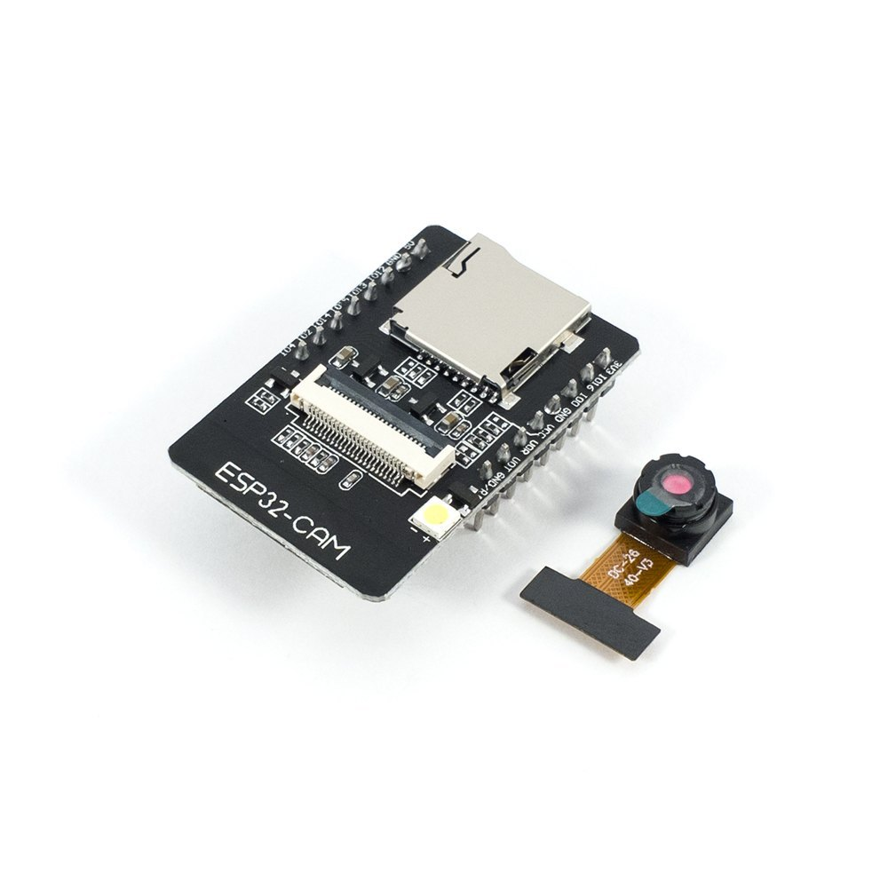
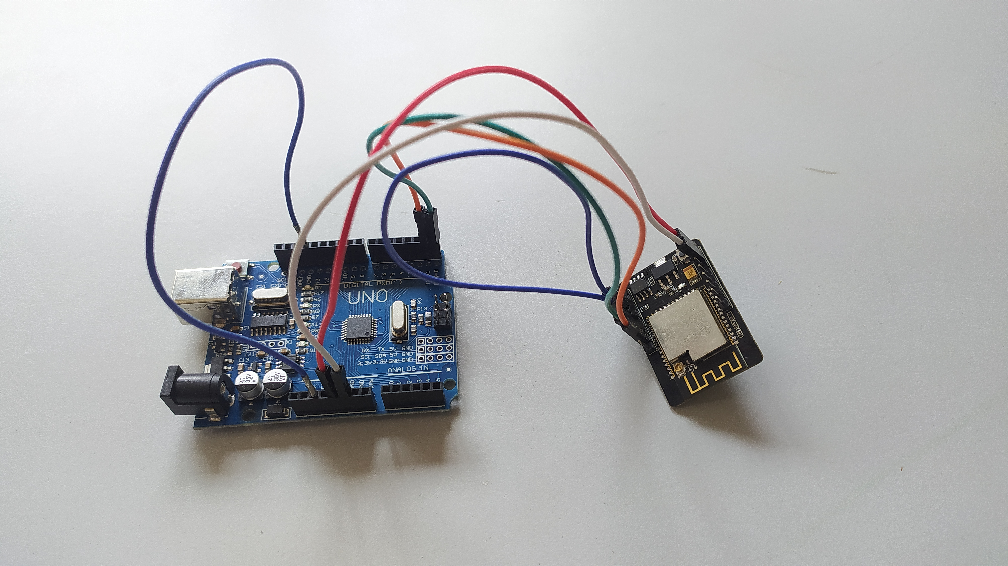
Working Model
ESP-32 Camera Module For Object detection
Self-Checkout Smart Store System

Slide 8
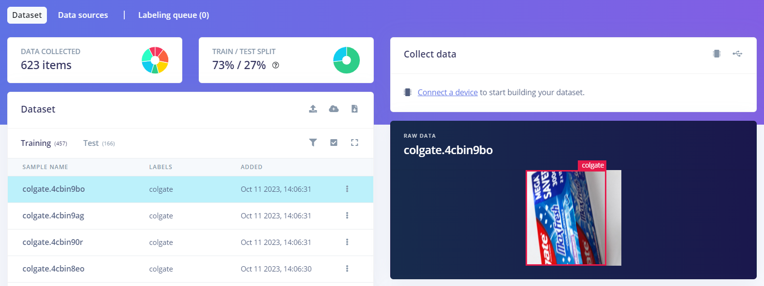
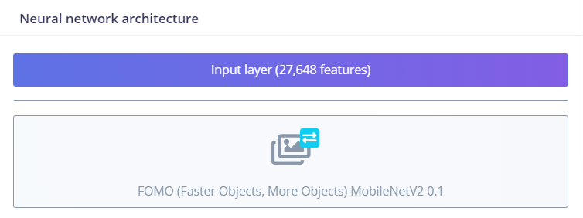
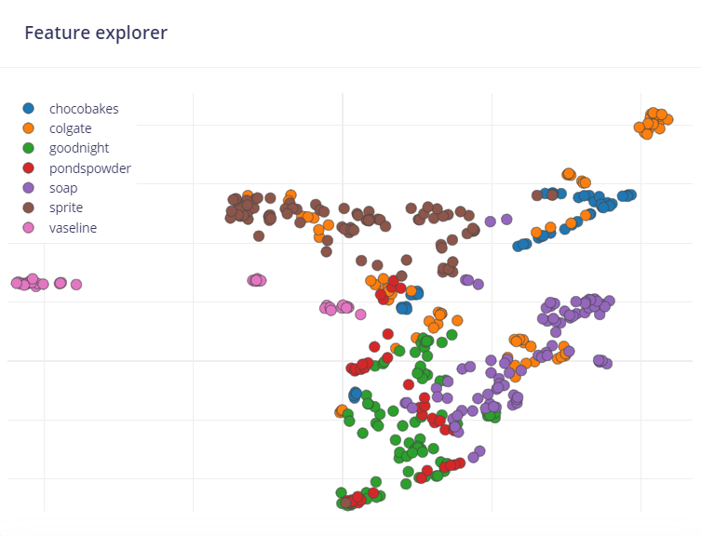
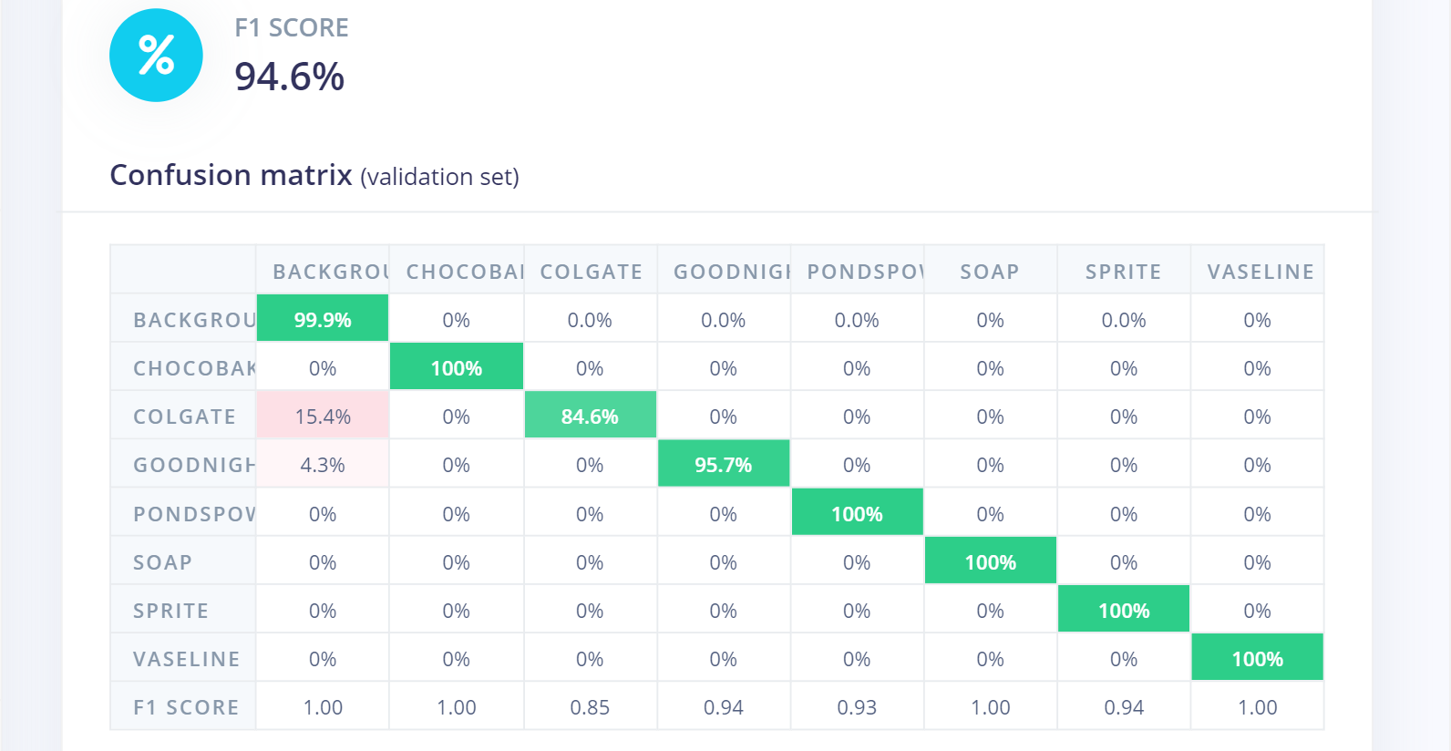
Results – ML Model
Self-Checkout Smart Store System

Slide 9
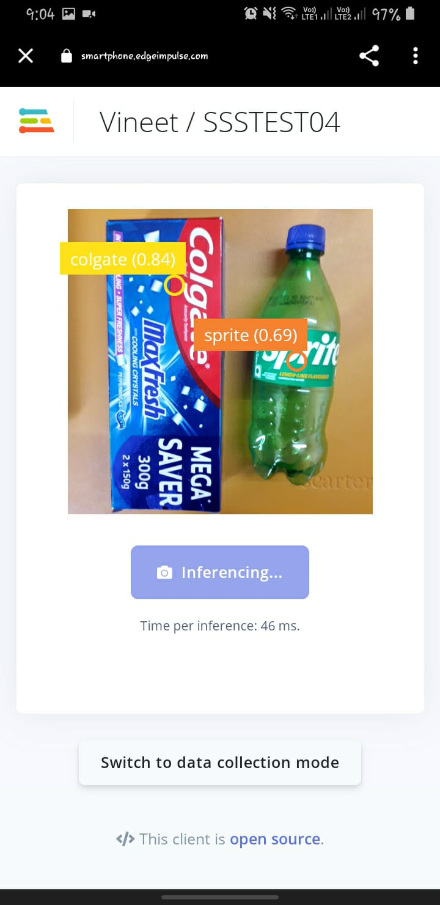
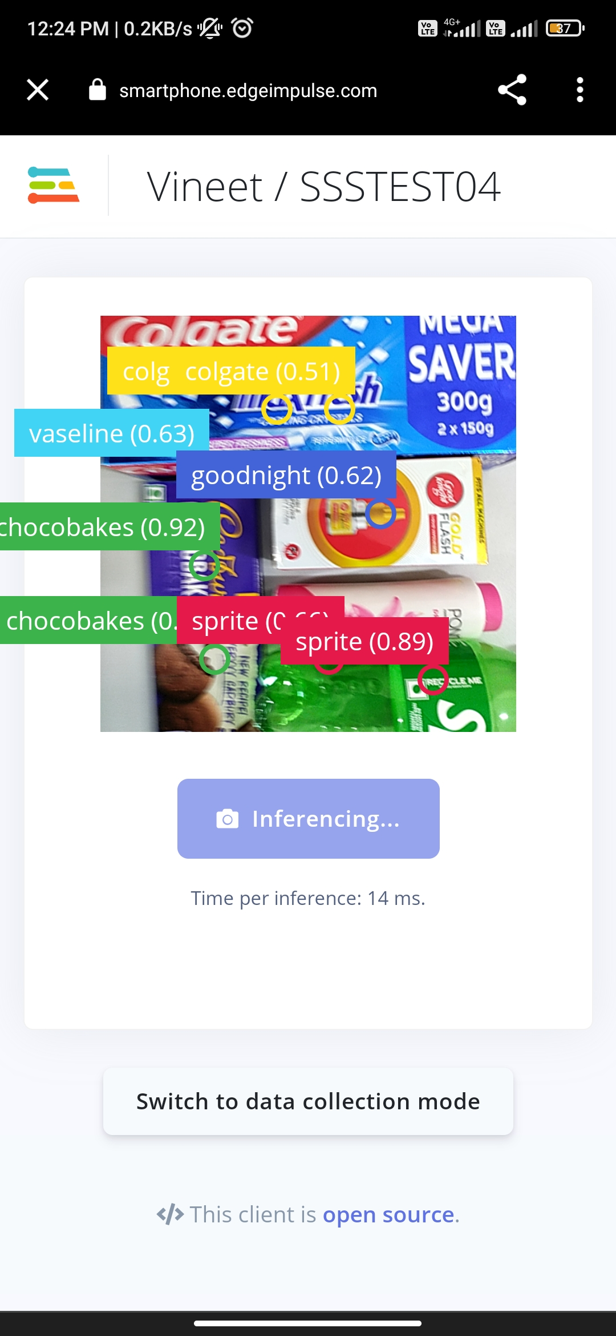
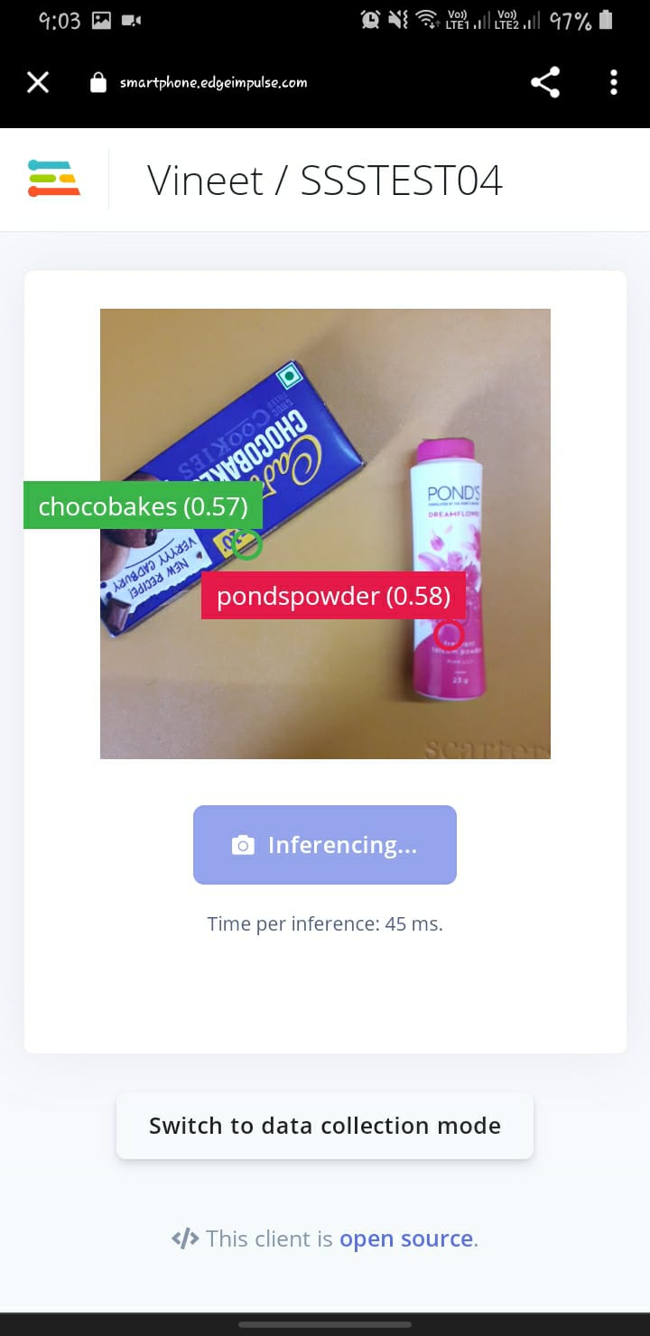
Results – Detect the object
Self-Checkout Smart Store System

Slide 10
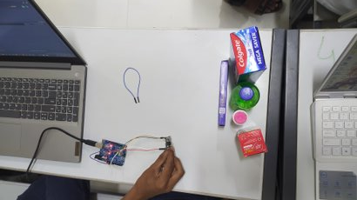
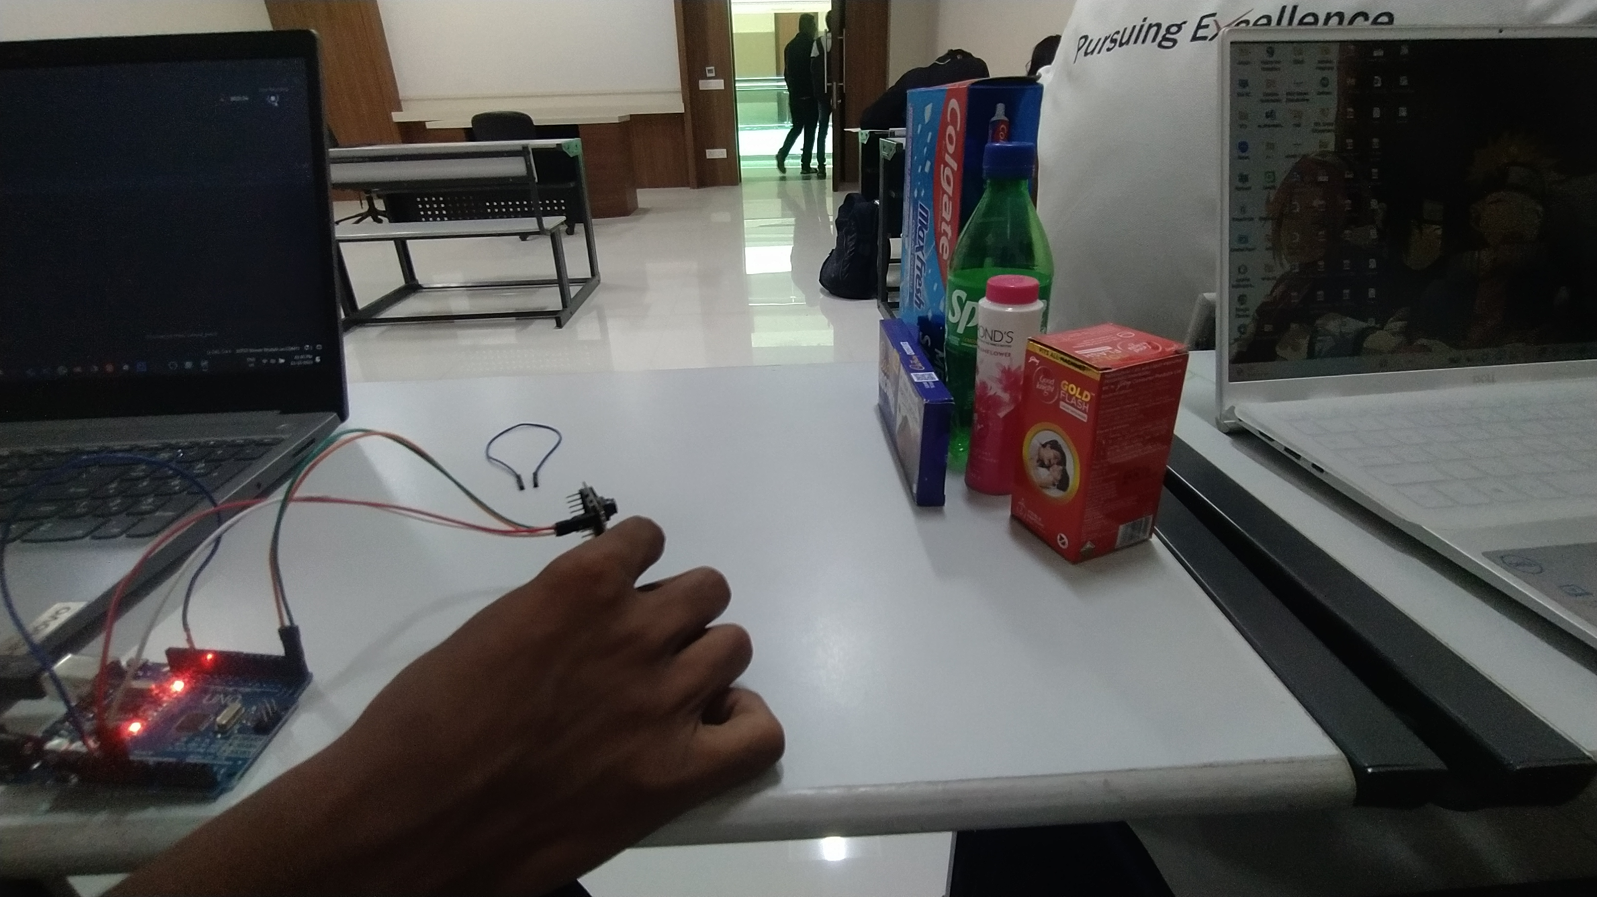
Results
Self-Checkout Smart Store System

Slide 11
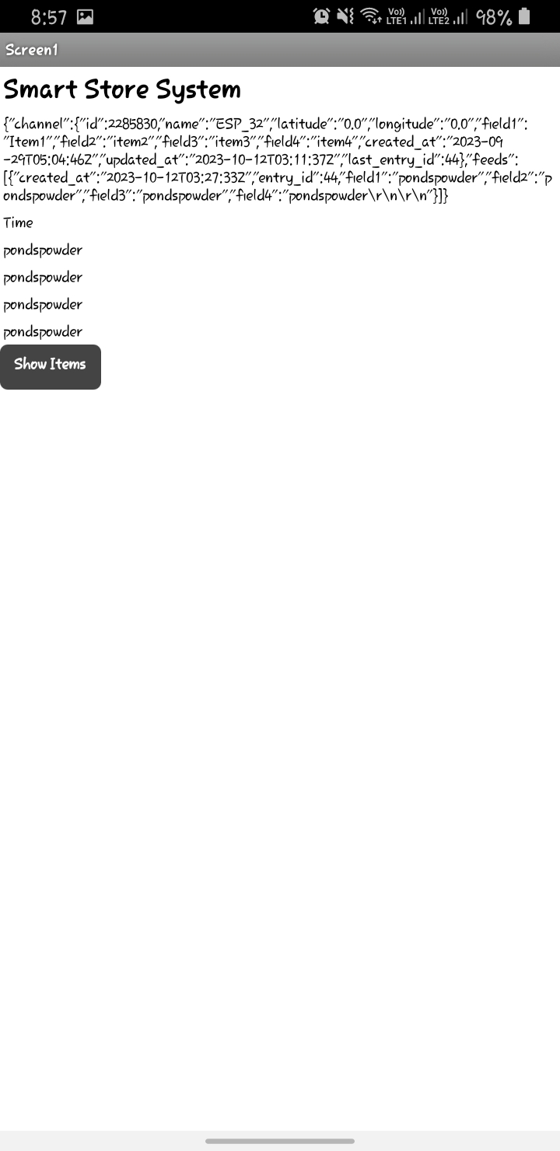

Results – Android Application
Self-Checkout Smart Store System

Slide 12
Conclusions
Enhanced Convenience: Self-checkout smart stores provide shoppers with a more seamless and efficient shopping experience. Customers can quickly make payments, and exit the store without waiting in long queues, saving valuable time and reducing frustration.
Improved Customer Satisfaction: With fewer checkout bottlenecks and a user-friendly interface, customers experience higher satisfaction levels when shopping at smart stores. The reduction in human error during the checkout process also contributes to a more positive shopping experience.
Reduced Theft and Fraud: The integration of advanced security measures, such as surveillance cameras, helps minimize theft and fraud instances, improving store profitability and loss prevention efforts.
Contactless Shopping: In growing demand for contactless experiences, self-checkout smart stores offer a safer shopping option, minimizing physical interactions.
Self-Checkout Smart Store System

